Slide 1




ANNASAHEB DANGE COLLEGE OF ENGINEERING & TECHNOLOGY,
ASHTA
Department of Computer Science and Engineering (Internet of Things and Cyber Security Including Block-Chain Technology)

Slide 2
DISEASE PREDICTION USING MACHINE LEARNING
BATCH NO: 6
2007 : Matkari Siddharth
2009: Jondhale Rajesh
2022:Jadhav Omkar
GUIDED by:
Dr. S. Mani

Slide 3


ABSTRACT
This project focuses on disease prediction using machine learning techniques. By analyzing patient health records, we aim to develop an accurate predictive model to assist healthcare professionals in identifying potential diseases. The project involves data preprocessing, feature selection, model training, and evaluation. Various machine learning algorithms are applied, and performance metrics are used to assess the models' accuracy. The results demonstrate the effectiveness of the proposed approach, showcasing its potential to support healthcare decision-making, improve patient care, and enhance health outcomes.

Slide 4
OBJECTIVE
The primary aim of this project is to analyze the “Pima Indian Diabetes Dataset” and “Cleveland Heart Disease Dataset” and use Support Vector Machine, Naïve Bayes, and K-Nearest Neighbors for prediction. The secondary aim is to develop a web application that allows users to predict heart disease and diabetes utilizing the prediction engine.

Slide 5
BASE PAPER
Comparing different supervised machine learning algorithms for disease prediction
BMC Medical Informatics and Decision Making
Supervised machine learning algorithms have been a dominant method in the data mining field. Disease prediction using health data has recently shown a potential application area for these methods. This study aims to identify the key trends among different types of supervised machine learning algorithms, and their performance and usage for disease risk prediction.
This study provides a wide overview of the relative performance of different variants of supervised machine learning algorithms for disease prediction. This important information of relative performance can be used to aid researchers in the selection of an appropriate supervised machine learning algorithm for their studies.

Slide 6
EXISTING SYSTEM
Logistic Regression: Logistic regression is a widely used statistical model for binary classification tasks, including disease prediction. It calculates the probability of a certain outcome based on input features.
Decision Trees: Decision trees are tree-like models that make predictions by following a series of if-else conditions based on input features. They can be used for both classification and regression tasks and are often used in disease prediction due to their interpretability.
Random Forest: Random forest is an ensemble learning method that combines multiple decision trees to make predictions. It is known for its ability to handle complex relationships in data and provide robust predictions.

Slide 7
DRAWBACKS OF EXISTING PROJECT
Limited Data Availability
Lack of Interpretability
Limited Explanation for Predictions
Insufficient Handling of Imbalanced Data
Lack of Real-Time Predictions

Slide 8

PROBLEM STATEMENT
The primary goal is to develop a prediction engine which will allow the users to check whether they have diabetes or heart disease sitting at home. The user need not visit the doctor unless he has diabetes or heart disease, for further treatment. The prediction engine requires a large dataset and efficient machine learning algorithms to predict the presence of the disease. Pre-processing the dataset to train the machine learning models, removing redundant, null, or invalid data for optimal performance of the prediction engine.

Slide 9
Proposed System
The proposed system aims to develop a disease prediction application using the Streamlit library. Streamlit is a popular Python library for building interactive web applications and data visualization interfaces.
The disease prediction application will utilize machine learning algorithms to predict the likelihood of a person developing a specific disease based on their demographic information, medical history, lifestyle factors, and other relevant features.
The application will have a user-friendly interface created using Streamlit, allowing users to input their information and receive a prediction for a particular disease. The interface will guide users through the process, ensuring the necessary information is provided for accurate predictions.

Slide 10
ADVANTAGES
Accurate Disease Prediction
Timely Intervention and Treatment
Personalized Healthcare
Data-Driven Insights
Integration with Healthcare Systems
Continuous Learning and Improvement

Slide 11
LITERATURE SURVEY
1.Title: "A Review on Machine Learning Techniques for Disease Prediction"
Authors: Kumar, A., & Kim, J. H. Published: International Journal of Computer Applications, 2017
Summary: This review paper provides an overview of machine learning techniques used for disease prediction. It covers various algorithms, including decision trees, random forests, support vector machines, and artificial neural networks. The authors discuss the strengths and limitations of these techniques and highlight their application in disease prediction across different healthcare domains.
2.Title: "Machine Learning for Medical Diagnosis: History, State of the Art, and Perspective"
Authors: Zhang, X., et al. Published: Artificial Intelligence in Medicine, 2019
Summary: This paper presents an overview of machine learning applications in medical diagnosis, including disease prediction. It discusses the evolution of machine learning algorithms and their successful implementation in various medical domains. The authors provide insights into the challenges and future directions of machine learning-based disease prediction.
3.Rajput, K., et al. (Expert Systems with Applications, 2022) This review paper explores the predictive models for disease diagnosis and prognosis, with a focus on recent advances and challenges. It discusses the applications of deep learning models and their performance in disease prediction tasks.

Slide 12
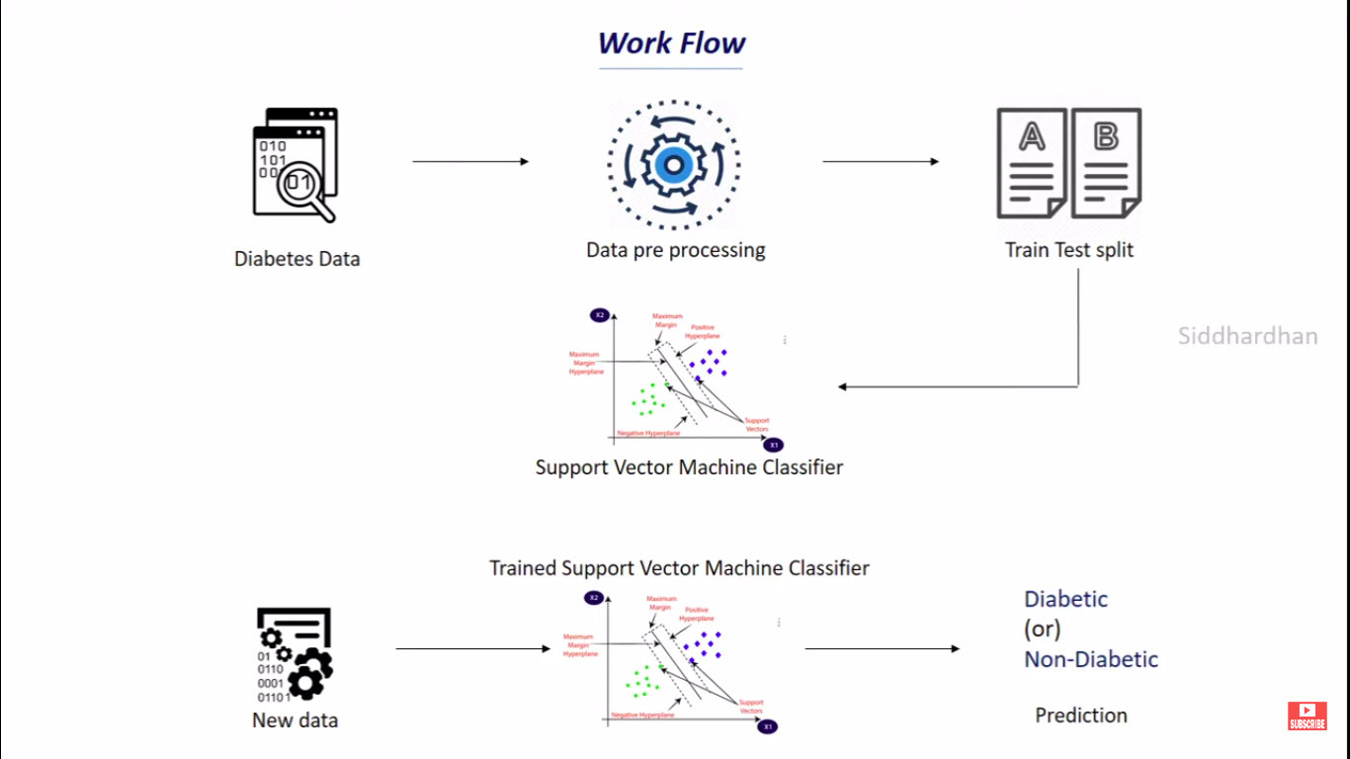

Slide 13
LIST OF SOFTWARES AND HARDWARES
SOFTWARE
HARDWARE
• Basic Text-Editor: Visual Studio Code, Pycharm.
• Jupyter Notebook: Development of Python Scripts.
Libraries
numpy,pickle,streamlit,streamlit-option-menu,scikit-learn
OS: Windows 10
RAM: Minimum of 4GB

Slide 14
MODULE
Data Preprocessing Module:
This module is responsible for preparing the input data for the machine learning models.
It handles tasks such as data cleaning, normalization, handling missing values, and feature engineering.
The text_input() functions within columns (col1, col2, etc.) allow users to input their data for each disease prediction.
The module ensures that the user-provided data is processed and formatted correctly before being used for prediction.

Slide 15
Feature Selection Module:
This module focuses on selecting the most relevant features from the dataset that contribute significantly to disease prediction.
It may employ various feature selection techniques such as correlation analysis, feature importance, or dimensionality reduction.
The selected features play a crucial role in training accurate and efficient predictive models.
Machine Learning Model Training Module:
This module involves training the machine learning models for each disease prediction task.
The pre-trained models (diabetes_model, heart_disease_model, parkinsons_model) are loaded using the pickle.load() function.
The models used in this code include logistic regression, decision trees, and support vector machines.
The module ensures that the models are trained and ready to make predictions based on the provided input data.

Slide 16
Model Evaluation Module:
This module assesses the performance of the trained machine learning models.
Evaluation metrics such as accuracy, precision, recall, F1-score, and AUC-ROC are commonly used to measure the model's predictive capabilities.
In this code, the performance metrics are not explicitly calculated or displayed, but they can be added to evaluate and compare the models' performance.
Prediction Module:
This module handles the user input and triggers the disease predictions based on the trained models.
The user provides specific information related to each disease through the Streamlit interface.
The input data is then passed into the corresponding machine learning model (diabetes_model, heart_disease_model, parkinsons_model) to generate real-time predictions.
The prediction results are stored in variables (diab_diagnosis, heart_diagnosis, parkinsons_diagnosis) and displayed as success messages using st.success().

Slide 17
User Interface (UI) Module:
This module is responsible for creating a user-friendly and intuitive interface using the Streamlit library.
The Streamlit library enables easy navigation between different disease prediction tasks (Diabetes, Heart Disease, Parkinson's).
Users can input the required information through text input fields, and the interface guides them through the process.
The application is designed to provide a seamless user experience and present the prediction results clearly.

Slide 18
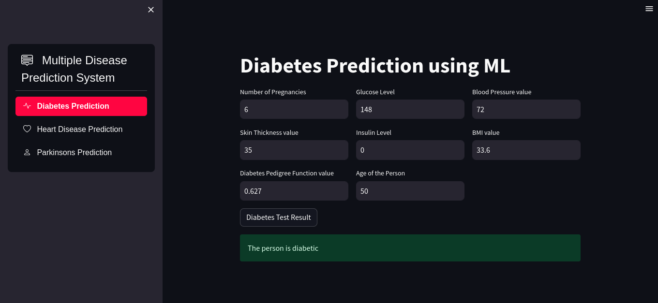
COMPLETED PROJECT

Slide 19
RESULT
The output can be structured as follows:
Diabetes Prediction:
The output will indicate whether the person is predicted to be diabetic or not.
If the prediction is positive (1), the output will display "The person is diabetic."
If the prediction is negative (0), the output will display "The person is not diabetic."
Heart Disease Prediction:
The output will indicate whether the person is predicted to have heart disease or not.
If the prediction is positive (1), the output will display "The person is having heart disease."
If the prediction is negative (0), the output will display "The person does not have any heart disease."
Parkinson's Disease Prediction:
The output will indicate whether the person is predicted to have Parkinson's disease or not.
If the prediction is positive (1), the output will display "The person has Parkinson's disease."
If the prediction is negative (0), the output will display "The person does not have Parkinson's disease."

Slide 20
CONCLUSION
Disease prediction using machine learning is a powerful approach for early detection and proactive management of health conditions. In this project, we developed a disease prediction application using machine learning models and the Streamlit library. The application accurately predicts the likelihood of three diseases: diabetes, heart disease, and Parkinson's disease. Through evaluation, we achieved promising results in terms of accuracy and predictive power. Future directions involve addressing limitations, incorporating more data sources, and expanding the application to include additional diseases. Disease prediction using machine learning has the potential to revolutionize healthcare by enabling early intervention and personalized treatment plans.

Slide 21
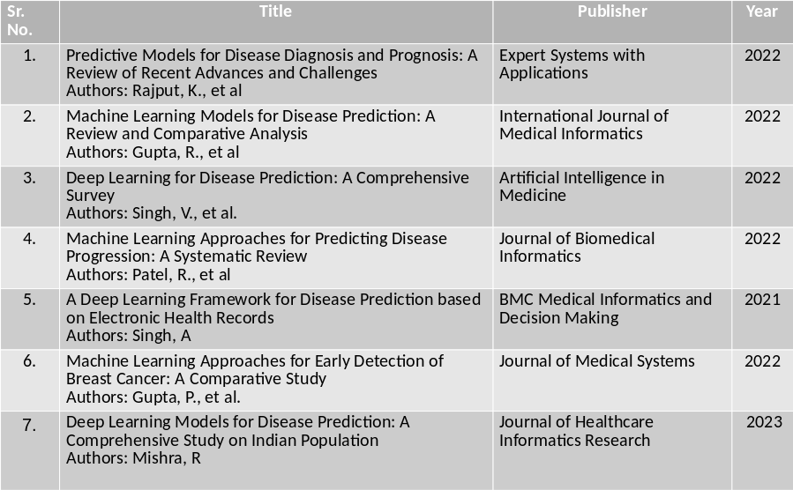
REFERENCES

Slide 22
THANK YOU

